Slide 1

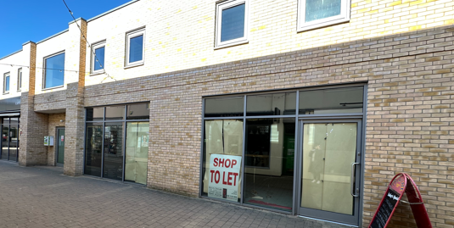
HUNTINGDON
Unit 31, Chequers Court Shopping Centre, PE29 3LJ
NEW LEASE AVAILABLE
LOCATION
Huntingdon is a strong affluent market town located approximately 15 miles north west of Cambridge and 19 miles south of Peterborough. National transport links are excellent via the A14 which links with the A1 and via the M11 connecting with the M25 and central London. The town has a resident population of approximately 18,000 and serves a catchment of 56,000 within a 10-minute drive time.
The premises occupy a prime location on the busiest footfall point in the popular Chequers Court location. Nearby occupiers include Clarks, Vision Express, and Greggs.
The Chequers Centre Extension is anchored by Next, M&S Foodhall and TK Maxx. Other retailers in the vicinity include Sainsburys, Superdrug, and Sports Direct.
ACCOMMODATION
The property provides the following approximate areas;
Ground Floor: 639 sq ft
First Floor: 937 sq ft
Total Area: 1,576 sq ft
LEASE TERM
A new effectively full repairing and insuring lease for a term to be agreed.
RENTAL
Available on application.
SERVICE CHARGE
Estimated to be £2,500 per annum
RATING
The property is assessed for rates as follows:
Rateable Value: £ 30,250
UBR 2025/26: 38.2p
Estimated Rates Payable: £ 11,555
This information is for guidance purposes only. Interested parties are advised to make their own enquiries with the VOA.
EPC
Available on request.
LEGAL COSTS
Each party shall be responsible for their own legal costs incurred in this transaction.
VIEWING AND FURTHER INFORMATION
All viewings should be made strictly via appointment with the joint agents:
Filippa Mudd
FMX
07917 034807
filippamudd@fmx.co.uk
Kevin Taylor
Kevin Taylor & Associates
07870 948444
kevin.taylor9@btconnect.com
FMX for themselves and for the vendors or lessors of this property whose agents they are give notices that: (i) The particulars are set out as a general outline only for the guidance of intending purchasers or lessees, and do not constitute, nor constitute part of, an offer or contract; (ii) All descriptions, dimensions, references to condition and necessary permission for the use and occupation, and other details are given in good faith and are believed to be correct, but intending purchasers or tenants should not rely on them as statements or representations of fact, but must satisfy themselves by inspection or otherwise as to the correctness of each of them; (iii) No person in the employment of MMX Retail has any authority to make or give any representation or warranty whatsoever in relation to this property.
Date: May 2026
4th Floor, 41-43 Maddox Street, London, W1S 2PD
www.fmx.co.uk

Slide 2
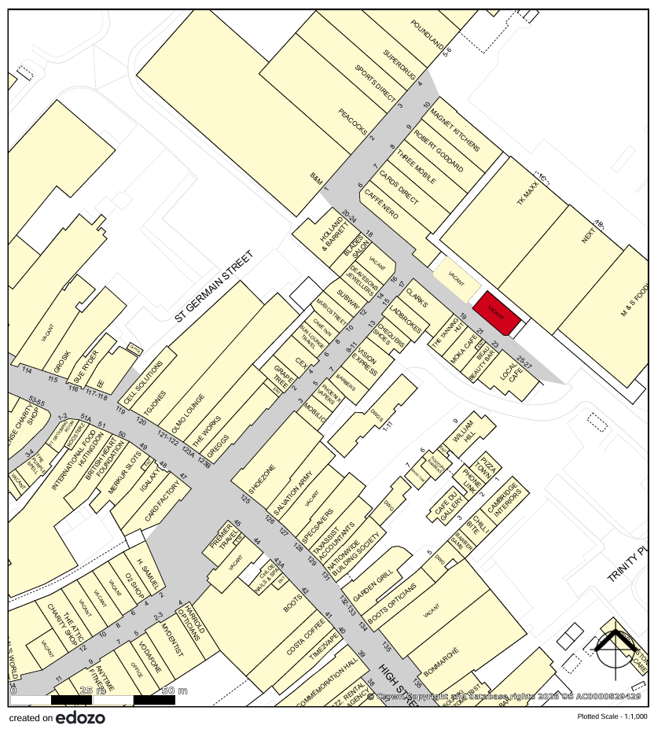
FMX for themselves and for the vendors or lessors of this property whose agents they are give notices that: (i) The particulars are set out as a general outline only for the guidance of intending purchasers or lessees, and do not constitute, nor constitute part of, an offer or contract; (ii) All descriptions, dimensions, references to condition and necessary permission for the use and occupation, and other details are given in good faith and are believed to be correct, but intending purchasers or tenants should not rely on them as statements or representations of fact, but must satisfy themselves by inspection or otherwise as to the correctness of each of them; (iii) No person in the employment of MMX Retail has any authority to make or give any representation or warranty whatsoever in relation to this property.
4th Floor, 41-43 Maddox Street, London, W1S 2PD
www.fmx.co.uk

